Slide 1
Ovarian reserve before and after endometrioma surgery
M. Ćorić

Slide 2
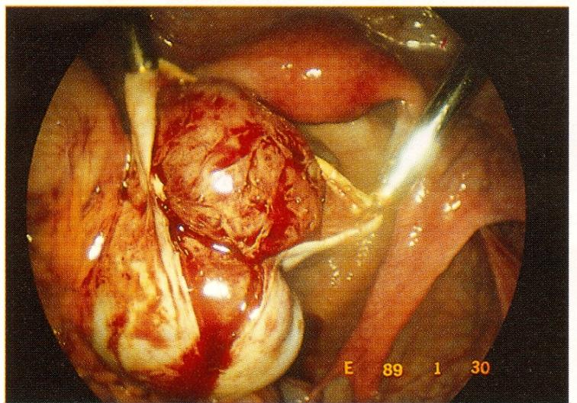
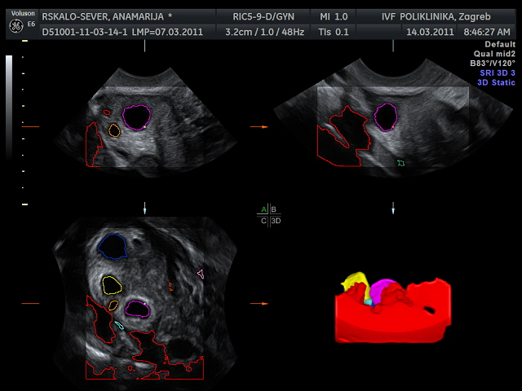
ovarian reserve
endometrioma surgery

Slide 3

Ovarian reserve
postponed childbearing (> 35)
ART (assisted reproductive technology)

Slide 4
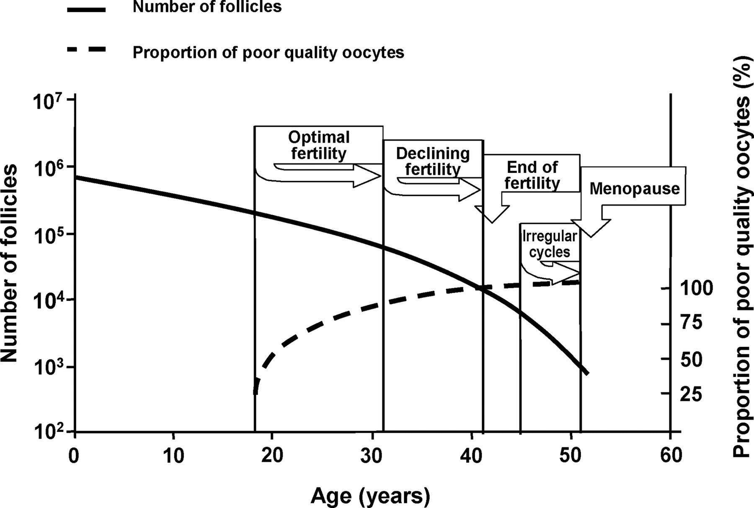

Schematic representation of the number of primordial follicles present in the ovaries and the chromosomal quality of oocytes in relation to female age and corresponding reproductive events.
Broekmans F J et al. Endocrine Reviews 2009;30:465-493
©2009 by Endocrine Society
Notes:
Schematic representation of the number of primordial follicles present in the ovaries and the chromosomal quality of oocytes in relation to female age and corresponding reproductive events. Graph was drawn after Hansen et al. (27 ) and de Bruin et al. (267 ).

Slide 5
Bussaca M.
LPSC treatment of endometrioma – complex surgery
technical difficulties
damage to the ovarian function
postoperative adhesion formation and subsequent tubal damage
bilaterally of the cyst and association with DE
frequency of recurrences (20%)
European Congress on Endometriosis Nov 29 – Dec 1, 2012 Siena – Italy
Journal of Endometriosis. 2012;4:210.

Slide 6

The treatment of ovarian endometrioma controversies:
endometrioma - infertility
increased fertility after surgery
utility of surgery for fertility purposes in women with endometriomas – ovarian damage
various surgical techniques (cystectomy vrs ablation)

Slide 7
The treatment of ovarian endometrioma
Favor of surgery
symptoms improvement after surgery
(Hart RJ et al: Ecisional surgery vrs ablative surgery. Cochrane Database Syst Rev 2008;16: CD004992)
increased fertility after surgery
(Donnez et al, Combined (hormonal and microsurgical) therapy in infertile women with endometriosis. Fertil Steril. 1987 Aug;48(2):239-42.
Jones KD et al :Pregnancy rates following ablative laparoscopic surgery for endometriomas. Hum Reprod. 2002 Mar;17(3):782-5)
increased risk for ovarian cancer
(Aris A: Endometriosis-associated ovarian cancer: A ten-year cohort study of women living in the Estrie Region of Quebec, Canada. J Ovarian Res. 2010 Jan 19;3:2. doi: 10.1186/1757-2215-3-2.
IVF –difficulty of accessing follicles – risk of pelvic infection (Zanetta G et al: Ultrasound-guided aspiration of endometriomas: possible applications and limitations. Fertil Steril. 1995 Oct;64(4):709-13.

Slide 8
The treatment of ovarian endometrioma
Against Surgery
deleterious effect of surgery on the ovarian reserve
the higher risk of premature ovarian failure
Busacca M et al:Endometrioma excision and ovarian reserve: a dangerous relation.J Minim Invasive Gynecol. 2009 Mar-Apr;16(2):142-8.
Ruiz-Flores FJ et al: Is there a benefit for surgery in endometrioma-associated infertility? all:Curr Opin Obstet Gynecol. 2012 Jun;24(3):136-40.

Slide 9
The treatment of ovarian endometrioma
Against Surgery
histologic analyses – 50% ovarian cortex in endometrioma vrs 6% well-defined capsule
Muzii L et al: Laparoscopic stripping of endometriomas: a randomized trial on different surgical techniques. Part II: pathological results.Hum Reprod. 2005 Jul;20(7):1987-92. Epub 2005 Apr 28.
electrocoagulation damage during hamostasis
Busacca M et al:Endometrioma excision and ovarian reserve: a dangerous relation.J Minim Invasive Gynecol. 2009 Mar-Apr;16(2):142-8.
Var T et al: The effect of laparoscopic ovarian cystectomy versus coagulation in bilateral endometriomas on ovarian reserve as determined by antral follicle count and ovarian volume: a prospective randomized study. Fertil Steril. 2011 Jun;95(7):2247-50.

Slide 10
The treatment of ovarian endometrioma
Against Surgery
markers of ovarian reserve
AFC (antral follicle count)
AMH
OVARIAN VOLUME
Mokdad C et al: Assessment of ovarian volume reduction with three-dimensional ultrasonography after cystectomy for endometrioma. Gynecol Obstet Fertil. 2012 Jan;40(1):4-9
Celik HG et al: Effect of laparoscopic excision of endometriomas on ovarian reserve: serial changes in the serum antimüllerian hormone levels. Fertil Steril. 2012 Jun;97(6):1472-8.
Chang HJ: Impact of laparoscopic cystectomy on ovarian reserve: serial changes of serum anti-Müllerian hormone levels. Fertil Steril. 2010 Jun;94(1):343-9

Slide 11
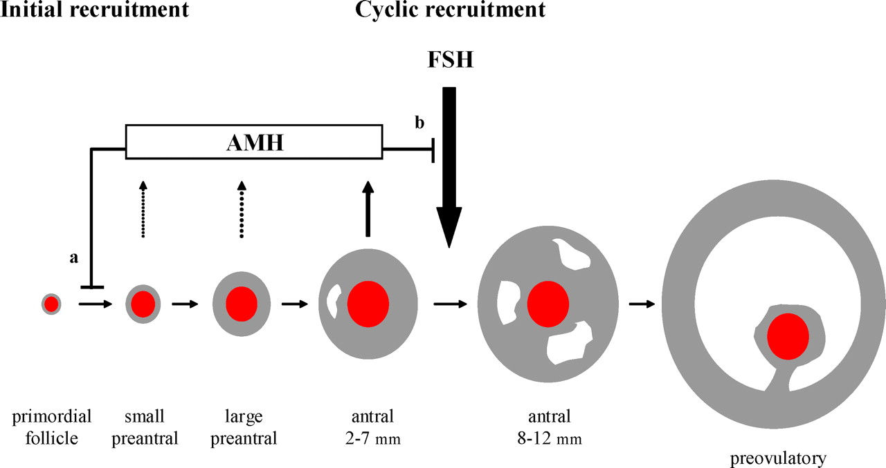
The role of AMH in ovarian follicle development (red center represents the oocyte, gray area the granulosa cell layer).
Broekmans F J et al. Endocrine Reviews 2009;30:465-493
©2009 by Endocrine Society
Notes:
The role of AMH in ovarian follicle development (red center represents the oocyte, gray area the granulosa cell layer). The inhibitory effects of AMH ⊣ are shown upon the recruitment of primary follicles from the resting primordial follicle pool (a) and the sensitivity of antral follicles for FSH and their ability to develop into a preovulatory follicle (b). Reprinted with permission from Ref. 327 .

Slide 12
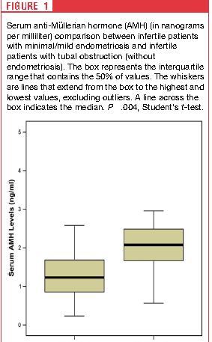
Decreased anti-Mullerian hormone and altered ovarian follicular cohort in infertile patients with minimal/mild endometriosis
N:17
p:0.004
N:17
EE
CC
Nadiane Albuquerque Lemos, 2009
Notes:
Objective: To evaluate the ovarian reserve and follicular cohort of infertile patients with minimal/mild endometriosis.
Design: Prospective study.
Setting: University hospital.
Patient(s): Patients were divided into two groups: group I, minimal/mild endometriosis and group II, tubal obstruction.
The following exclusion criteria were established: [1] patients with previous endocrine disorders; and
[2] cases in which the cause for infertility was other than endometriosis (except for patients with tubal obstruction,
in the control group).
Intervention(s): Serum FSH and anti-M€ullerian hormone were measured on day 3. On the same day all patients
were submitted to transvaginal ultrasound to evaluate the antral follicular count and the ovarian follicular cohort.
Main Outcome Measure(s): Serum FSH, anti-M€ullerian hormone, and the follicular cohort with the respective
antral follicular count.
Result(s): Serum FSH were not different between the groups. However, infertile patients with endometriosis have
a decreased serum anti-Mullerian hormone (1.26 0.7 ng/mL) compared to the control group (2.02 0.72 ng/mL).
The analysis of follicular cohort showed that the number of selectable follicles were similar, but the follicular
diameter was different.
Conclusion(s): Minimal/mild endometriosis is associated with a decrease in the follicular ovarian reserve. In addition,
the follicular cohort of these patients is more heterogeneous in comparison to the control group.

Slide 13
Anti mullerian hormone serum levels in women with endometriosis:
A case–control study
909 patients undergoing in vitro fertilisation/ intracytoplasmic sperm injection (IVF/ICSI) treatment or consulting our specific endometriosis unit.
Mean AMH serum level was significantly lower in the study than in the control group (2.75+2.0 ng/ml vs. 3.46+2.30 ng/ml, p 0.001).
In women with mild endometriosis (rAFS I-II), the mean AMH level was almost equal to the control group (3.28+1.93 ng/ml vs. 3.44+2.06 ng/ml; p 0.61).
A significant difference in mean AMH serum level was found between women with severe endometriosis (rAFS III-IV) and the control group (2.38+1.83 ng/ml vs. 3.58+2.46 ng/ml; p 0.0001).
OMAR SHEBL, 2009
Notes:
Objective. To compare the anti muellerian hormone (AMH) serum levels in women with and without endometriosis.
Design. A case–control study
Setting. Women’s General Hospital, Linz, Austria.
Patient(s). Our study included a total of 909 patients undergoing in vitro fertilisation/intracytoplasmic sperm injection
(IVF/ICSI) treatment or consulting our specific endometriosis unit. After proofing the exclusion criteria, 153 of these
patients with endometriosis (study group) were matched with 306 patients undergoing IVF/ICSI treatment because of a male
factor (control group).
Interventions. None.
Main outcome measures. AMH serum level.
Results. Mean AMH serum level was significantly lower in the study than in the control group (2.75+2.0 ng/ml vs.
3.46+2.30 ng/ml, p50.001). In women with mild endometriosis (rAFS I-II), the mean AMH level was almost equal to the
control group (3.28+1.93 ng/ml vs. 3.44+2.06 ng/ml; p¼0.61). A significant difference in mean AMH serum level was
found between women with severe endometriosis (rAFS III-IV) and the control group (2.38+1.83 ng/ml vs.
3.58+2.46 ng/ml; p50.0001).
Conclusion. Lower AMH serum levels and an association with the severity were found in women with endometriosis.
Physicians have to be aware of this fact. Because of the expected lower response on a controlled ovarian hyperstimulation
(COH), AMH serum level should be measured to optimise the dose of gonadotropin treatment previous to a COH,
especially in women with severe endometriosis.

Slide 14

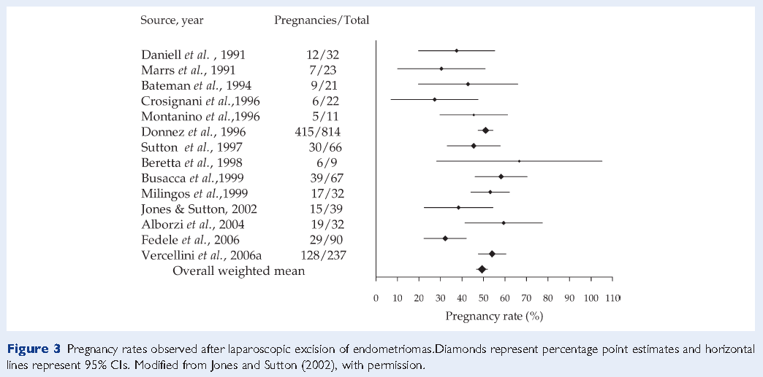

Slide 15
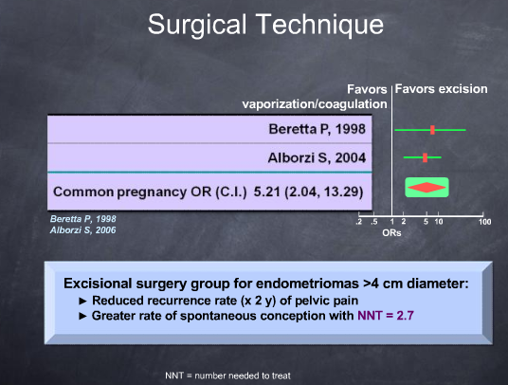

Slide 16
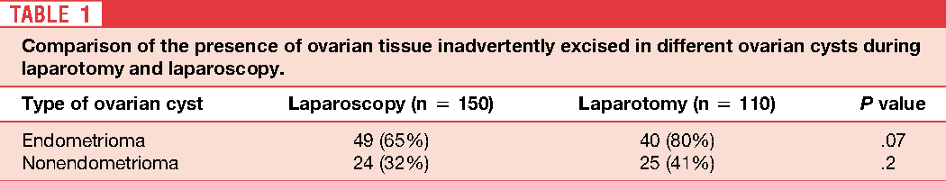
A comparison of histopathologic findings of ovarian tissue inadvertently excised with endometrioma and other kinds of benign ovarian cyst in patients undergoing laparoscopy versus laparotomy
The surgical approach had no statistically significant impact on conservation of ovarian reserves.
The nature of the ovarian cyst played a greater role in the quality and quantity of the excised ovarian tissue
Saeed Alborzi, 2009
Notes:
Objective: To evaluate ovarian tissue inadvertently excised with benign cysts during laparotomy or laparoscopy.
Design: Prospective study.
Setting: Private and university hospitals.
Patient(s): 260 women, 20 to 35 years old, with unilateral benign ovarian cysts.
Intervention(s): One hundred fifty women operated by laparoscopic cystectomy stripping technique, and 110
women operated by laparotomy with the same technique.
Main Outcome Measure(s): Histopathologic findings of ovarian tissue inadvertently excised in endometrioma
compared with other kinds of benign cysts in laparoscopy versus laparotomy.
Result(s): In the laparoscopy group, ovarian tissue was present in 65% of endometrioma and in 32% of nonendometriotic
cysts. In the laparotomy group, ovarian tissue was seen in 80% of endometrioma and 41% of nonendometriotic
cysts.
Conclusion(s): The surgical approach had no statistically significant impact on conservation of ovarian reserves.
The nature of the ovarian cyst played a greater role in the quality and quantity of the excised ovarian tissue

Slide 17
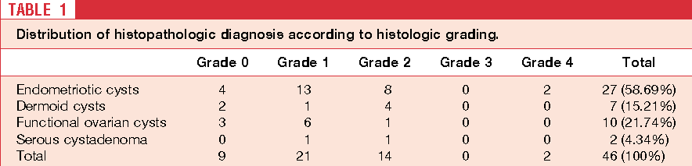
Excision of endometriotic cyst wall may cause loss of functional ovarian tissue
N:46
Umut Dilek, 2006
Notes:
After excising the cyst wall completely, the same pathologist,
blinded to the clinical and surgical history of the
patient, evaluated five different full-thickness sections including
four different sections from the periphery of the
cyst and one section from the central portion. Cyst wall was
evaluated for the presence or absence of ovarian tissue
adjacent to the excised cyst wall and graded according to
semiquantitave scale of 0 to 4 (7). The pathologist evaluated
the cyst wall according to morphologic characteristics
of the excised ovarian tissue within the cyst wall. In this
regard, complete absence of follicles was described as grade 0,
presence of only primordial follicles was grade 1, presence of
primordial and primary follicles were grade 2, and detection
of secondary follicles was grade 3 and grade 4.
Endometriotic cysts and infertility is a well known association.
Ovarian endometriomas could affect the response to
ovarian stimulation, oocyte recovery, and implantation and
fertilization rates (1). In addition, repeated ovarian surgeries
for recurrent endometriomas might be associated with
the loss of ovarian reserve.
Pathogenesis of ovarian endometriomas is still controversial.
Inversion and progressive invagination of the superficial
ovarian endometriotic implants into the ovarian
cortex is a well known hypothesis (2). However, metaplasia
of invaginated coelomic epithelium is another proposed
mechanism in the genesis of ovarian endometriomas (1).
Cyst aspiration, fenestration, and ablation of cyst wall by
laser or electrocoagulation are commonly performed surgical
procedures for the treatment of endometriotic cysts
(1). Excision of the cyst wall is accepted technique for
surgical treatment of ovarian endometriotic cysts owing to
low recurrence rates (3, 4). The excision of the cyst wall is
disputable because it may result in loss of normal ovarian
tissue (5). However, Muzii et al. (6) reported that they were
able to save the normal ovarian tissue by using stripping
technique at laparoscopic cyst removal. In this study, we
aimed to determine whether the stripping of cyst wall by
laparoscopy is a tissue sparing technique.
Between 2002 and 2004, 46 patients underwent laparoscopic
cyst excision because of chronic pelvic pain, infertility,
dysmenorrhea, and persistent ovarian cystic mass.
Ultrasonographic examination was performed by GE Logiq
500 Pro (Milwaukee, WI) and 3.5-MHz convex probe and
6.5-MHz transvaginal probe. Serum CA-125 levels were
determined from all subjects preoperatively.
Women with body mass greater than 30 kg/m2, history
of earlier ovarian surgery, especially due to ovarian endometriomas,
history of GnRH analogs and oral contraceptive
use, bilateral ovarian cysts, and multiple ovarian cysts that
were occupying the same ovary were excluded. Selected
cases underwent laparoscopic cyst removal. The same surgical
team performed laparoscopic cystectomy in the dorsal
lithotomy position in all subjects.
In case of ultrasonographic diagnosis of dermoid cyst,
the cyst was not punctured and every effort was made to
excise the entire cyst without spilling its sebaceous content.
Other cysts including endometriomas were punctured and
aspirated. Following the puncture, the surgeon found the
cleavage plane and stripped cyst wall from the normal
ovarian tissue by traction and countertraction.
After excising the cyst wall completely, the same pathologist,
blinded to the clinical and surgical history of the
patient, evaluated five different full-thickness sections including
four different sections from the periphery of the
cyst and one section from the central portion. Cyst wall was
evaluated for the presence or absence of ovarian tissue
adjacent to the excised cyst wall and graded according to
semiquantitave scale of 0 to 4 (7). The pathologist evaluated
the cyst wall according to morphologic characteristics
of the excised ovarian tissue within the cyst wall. In this
regard, complete absence of follicles was described as grade 0,
presence of only primordial follicles was grade 1, presence of
primordial and primary follicles were grade 2, and detection
of secondary follicles was grade 3 and grade 4.
To compare continuous variables, Student t test was
used. Chi-squared or Fisher exact test was used for comparison
of categorical variables. P.05 was considered
statistically significant. We did not request institutional
review board approval for the study, because it did not
change our management of the patients with ovarian cysts
as usually followed at our center. In addition, cystectomy
by route of laparoscopy or laparotomy is standard procedure
at our center for ovarian cysts except under suspicion
of malignancy.
Laparoscopic cystectomy was completed successfully in
the 46 patients, and no intraoperative or postoperative
complications were seen. Thirteen patients (28.2%) underwent
laparoscopy because of persistence of ovarian cystic
mass. Infertility in 7 patients (15.2%), chronic pelvic pain,
and cyclic dysmenorrhea in 26 patients (56.52%) wereother indications for laparoscopic intervention. As a first
step, the surgeon aspirated cyst content in 39 cases
(84.7%). We preferred bipolar electrocautery to achieve
hemostasis in 40 cases (87%), and reconstruction by laparoscopic
suture was required in only 2 cases (4.34%).
Histopathologic diagnosis of the surgical specimens and
grading of residual ovarian tissue are shown in Table 1.
Two endometriotic cyst walls were histopathologic grade 4.
There is no statistical difference between the endometriotic
cysts and nonendometriotic cysts for presence of normal
ovarian tissue adjacent to removed cyst wall (P.414).
However, there is a statistically significant difference between
the preoperative ultrasonographic diameter of ovarian
cyst and presence of normal ovarian tissue adjacent to
removed cyst wall (P.02), although this correlation was
weak (Pearson correlation coefficient 0.377).

Slide 18
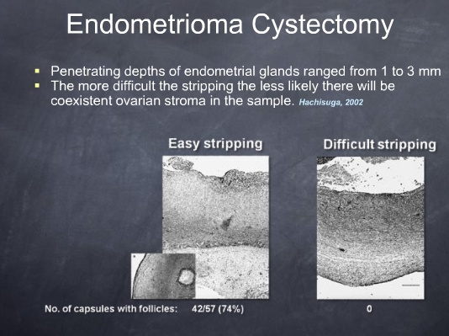

Slide 19
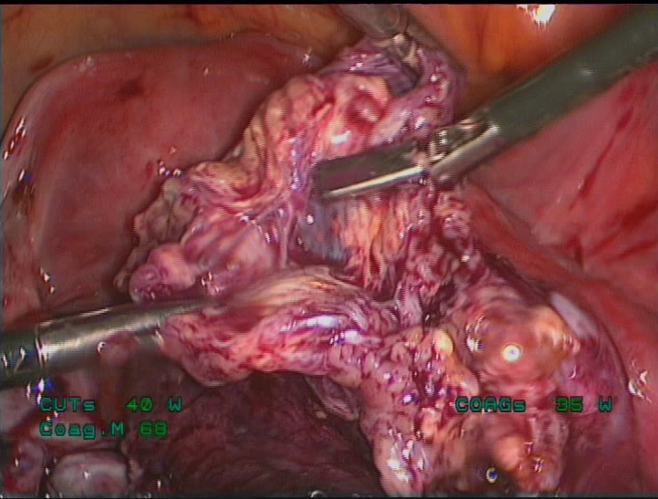

Slide 20
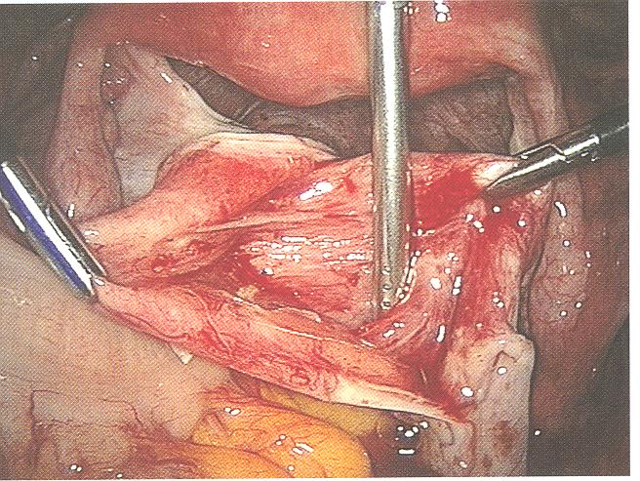

Slide 21
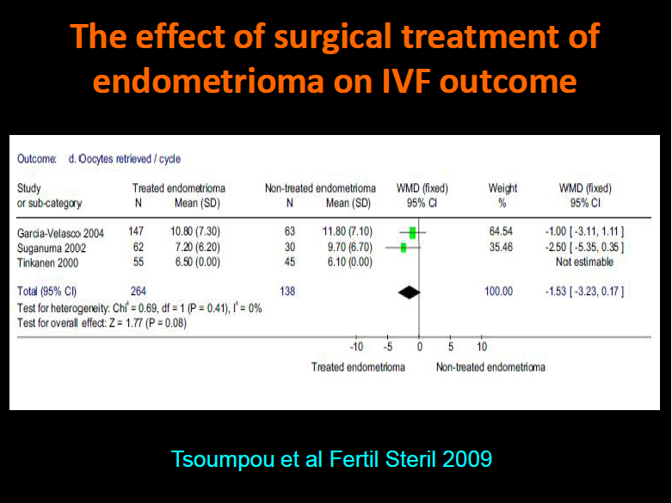

Slide 22
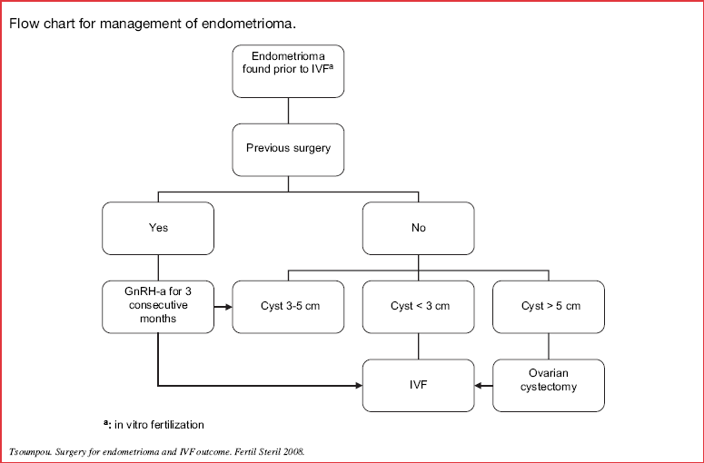

Slide 23
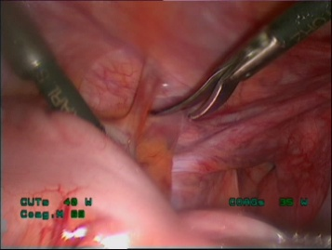

Slide 24
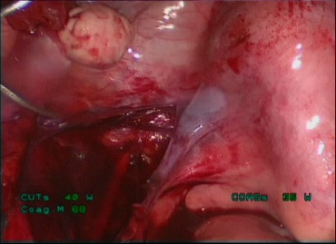

Slide 25
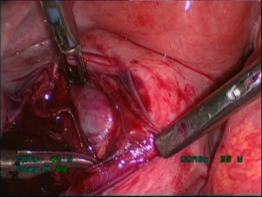

Slide 26
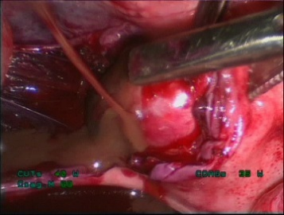

Slide 27
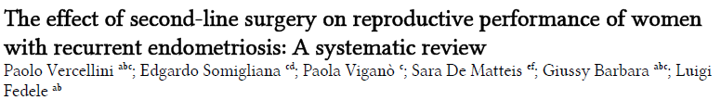
Spontaneous Pregnancy After 1° surgery 236/577 (41%)
Spontaneous Pregnancy After 2° surgery 28/124 (23%)

Slide 29
Correct surgical techique of the cyst excision procedure
identification of the correct plane of cleavage
progression of the excision in the area of the hilus
post excision hemosthasis

Slide 30
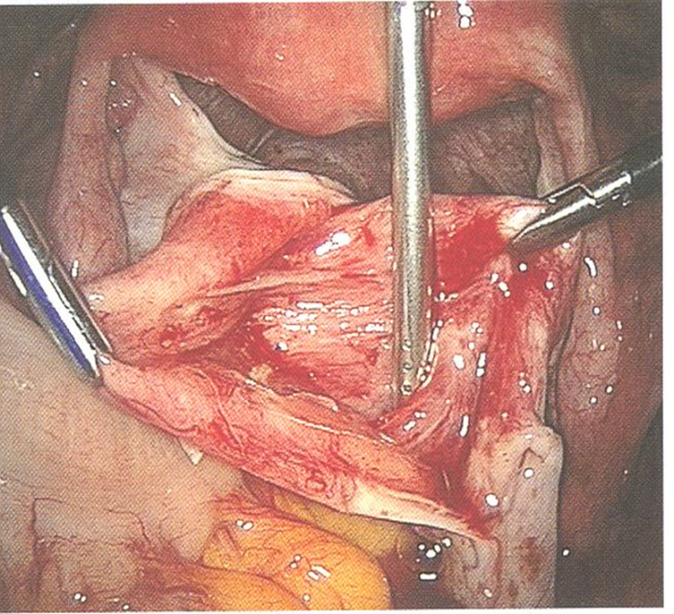
AMH LEVEL DID NOT DECREASE IN THREE-STEP APPROACH
(10 PATIENTS !!)
Tsolakidids D et al: Fertil Steril 2010; 94:71-7.
Lpsc Stripping vrs
Three-step approach
1. LPSC DRAINAGE
2. GnRH analogues 3 months
3. LPSC laser vaporization

Slide 31
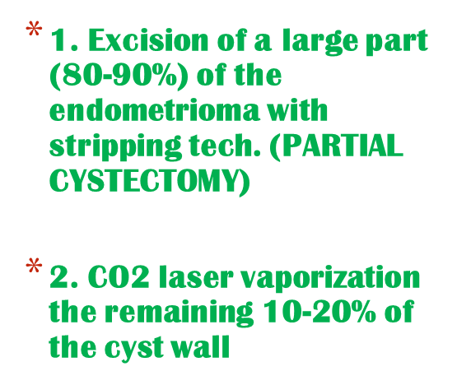
Donnez J et al. Fertil Steril 2010.94:28-32
Donnez mixed technique

Slide 32
Surgical control group- nonendometriotic cysts
Somigliana E et al. Does laparoscopic removal of nonendometriotic benign ovarian cysts affect ovarian reserve Acta Obstet Gynecol Scand. 2006;85(1):74-7
Yes
.

Slide 33
Surgical control group- nonendometriotic cysts
Chang HJ: Impact of laparoscopic cystectomy on ovarian reserve: serial changes of serum AMH levels. Fertil Steril. 2010 Jun;94(1):343-9
Kitajima M et al. Changes in serum AMH levels may predict damage to residual normal ovarian tissue after laparoscopic surgery for women with ovarian endometrioma. Fertil Steril 2011;95:2589-91.
Exacoustos C. et al. Laparoscopic removal of endometriomas: sonographic evaluation of residual functioning ovarian tissue. Am J Obstet Gynecol 2004; 191:68-72.
AMH LEVELS DECREASED
OVARIAN VOLUME DECREASED

Slide 34
Surgical control group- MYOMECTOMY ??
Iwase et al. Serum AMH level is a useful marker for evaluating the impact of lpsc cystectomy on ovarian reserve. Fertil Steril 2010;94:2846-9.
AMH LEVELS DECREASED

Slide 35
Chang HJ et al. Fertil Steril 2010; 94:343-9.
Lee et al. Gynecol Endocrinol 2011; 27:733-6.
Ćorić et al. Arch Gynecol Obstet. 2011 Feb;283(2):373-8.
Stripping procedure
AMH declilnes
AFC declines
AMH steady levels =
AFC declines
Ercan et al. Gynecol Endocrinol 2010;26:468-72.
Ercan et al. Eur J Obstet Gycexol Reprod Biol 2011;158:280-4.

Slide 36
Recurrent endometrioma
high risk for additional damage of ovarian reserve
can remain asymptomatic and do not necessarily progress in size with or without medical treatment.
decision to reoperate depends less on the endometrioma's size than on symptoms
such patients are also more likely to have signs of deep nodules and adnexal/bowel adhesions and larger endometriomas on TVS scan, thus predisposing them to require a second procedure.
Exacoustos C. et al. Recurrence of endometriomas after laparoscopic removal: sonographic and clinical follow-up and indication for second surgery. J Minim Invasive Gynecol 2006 Jul-Aug;13(4):281-8.

Slide 37
Risk for recurrent endometrioma
Ovarian responsiveness is higher in gonads that developed recurrent endometriomas.
Somigliana E et al. Recurrent endometrioma and ovarian reserve: biological connection or surgical paradox? Am J Obstet Gynecol 2011;204(6):529.e1-5.

Slide 38
Yu HT, Huang HY, Soong Yk, Lee CL, Xhao A, Wang CJ.
Laparoscopic ovarian cystectomy of endometriomas: surgeons' experience may affect ovarian reserve and live-born rate in infertile patients with in vitro fertilization-intracytoplasmic sperm injection.
Eur J Obstet Gycexol Reprod Biol 2010;152:172-5

Slide 39
Muzii et al.
Histologic analysis of specimens from laparoscopic endometrioma excision performed by different surgeons: does the surgeon matter?
Fertil Steril. 2011 May;95(6):2116-9.

Slide 40
CONCLUSIONS:
AMH level modifications supports a surgery-related damage to ovarian reserve
Examine argumets in favor of and against surgical treatment accordin to each patient’s situation to consider them in context
Pregnancy should be the main outcome measure
Surgery is the gold standard treatment for ovarian endmetriomas and should be performed with proper techiques by specifically trained surgeons in order to decrease the damage and maintain the ovarian reserve
Studies aimed at clarifying risk factors for the damage and a better understanding of the mechanisms causing tha damage are required

Slide 41

....beautiful black eyes were watching out of this window....

